Slide 1
Overview of CICS Integration Options
CICS Integration Wildfire Workshop
IBM Washington Systems Center
Leigh Compton, lcompton@us.ibm.com
Steve Fowlkes, fowlkes@us.ibm.com

Slide 2
Topic Abstract
This topic is an overview of all CICS integration technologies. While all connectivity options will be surveyed, emphasis will be placed on the newer connectivity options that enable Web services, REST services, Atom feeds, Event processing, Servlets and JSPs, and SCA.

Slide 3
Trademarks
The following terms are trademarks of the International Business Machines Corporation or/and Lotus Development Corporation in the United States, other countries, or both:
Redbooks(logo)™, AIX®, alphaWorks®, CICS®, DB2®, IBM®, IMS™, Informix®, MQSeries®, VisualAge®, WebSphere®
The following terms are trademarks of other companies:
Microsoft, Windows, Windows NT, and the Windows logo are trademarks of Microsoft Corporation.
Java and all Java-based trademarks and logos are trademarks or registered trademarks of Oracle, Inc.
CORBA, CORBAServices, and IIOP are trademarks of the Object Management Group, Inc.
UNIX is a registered trademark of The Open Group in the United States and other countries.
Other company, product, and service names may be trademarks or service marks of others.

Slide 4
Notices
This information was developed for products and services offered in the U.S.A. IBM may not offer the products, services, or features discussed in this presentation in other countries.
INTERNATIONAL BUSINESS MACHINES CORPORATION PROVIDES THIS PRESENTATION "AS IS" WITHOUT WARRANTY OF ANY KIND, EITHER EXPRESS OR IMPLIED, INCLUDING, BUT NOT LIMITED TO, THE IMPLIED WARRANTIES OR CONDITIONS OF NON-INFRINGEMENT, MERCHANTABILTY OR FITNESS FOR A PARTICULAR PURPOSE.
This information could include technical inaccuracies or typographical errors. IBM may make improvements and/or changes in the product(s) and/or the program(s) described in this presentation at any time without notice.
Any references in this presentation to non-IBM Web sites are provided for convenience only and do not in any manner serve as an endorsement of those Web sites. The materials at those Web sites are not part of the materials for this IBM product and use of those Web sites is at your own risk.

Slide 5
Agenda
CICS in the Server Role
TCP/IP
HTTP
Web Support
Web Services
REST Services
ATOM Support
Servlets and JSPs
IPIC
SNA
WMQ
Cross Memory: EXCI and WOLA
Event Processing
Java

Slide 6
CICS Application Architecture
CICS TS
Business Function
Presentation/Connectivity:
- 3270 device
- Web browser
- REST service
- Web service
- MQ
Business Rules
logic
Integration logic
Data access
Client
P
I
B
D
Best practice in CICS application design is to separate key elements of the application, in particular:
Presentation logic - 3270, HTML, XML, JSON, Servlets
Integration or Aggregation logic - Menu, router, tooling
Business Rules logic - Reusable component
Data access logic - VSAM, DB2, IMS, …
Provides a framework for reuse and facilitates separation of concerns, clear interfaces, ownership, and optimization

Slide 7
Notes
There is often some confusion while discussing the various Integration options with CICS as to the type of CICS program that can be invoked. For most integration options, the interface to your business logic will be a LINK passing a COMMAREA or a Channel with Containers. If you have very old programs where the business logic is locked behind a 3270 Interface, the Service Flow Feature (SFF) can aggregate (combine) a series of 3270 screen invocations into what looks like a COMMAREA or channel and container callable program. Additionally, you could write your own frontend to the 3270-based logic using the Link3270 Bridge or FEPI.
New for CICS TS V5.1 is the use of Java Servlets and JSPs to front-end CICS applications. These Java applications execute within a Java web container based on the WAS Liberty profile
Best practices for CICS application design for several years has been to divide the presentation from the business function. Often the business function is divided into integration logic, business rules logic, and data access logic.
If you have followed this best practice, you can easily reuse your business functions by adding logic to interface with user in a variety of ways, or by adding logic to connect to a different client or system.
The following slides will review the various options to access date from and to CICS, and the various technologies behind the various options.

Slide 8
CICS Technologies for Connectivity
Events
CICS Event Processing (multiple transports) *
SFM
Service Flow Feature (re-purpose 3270-based apps)
SCA
Software Component Architecture
CICS TS
HTTP (Web services, REST services,
ATOM feed, and Web browser interaction)
Sockets
CICS Java Web Container based on WAS Liberty technology
TCP/IP***
IPIC Inter-Region
CICS TG (ECI or IPIC)
LU 6.2 and Inter-Region
Business Function
SNA
3270 Terminal (LU 2)
P
I
B
D
CICS TG
WMQ
WMQ DPL Bridge
WMQ Attachment Facility
WMQ Web Service Transport
** Rules Engine
****Data
WOLA
Cross Memory
EXCI
* Events can have different transports or CICS can process its own events
** IBM Operational Decision Manager
*** IBM Worklight – can access CICS Data using REST, Web Services, and ATOM feeds
**** VSAM, DB2, and IMS

Slide 9
Notes
WMQ, SNA, and TCP/IP are the three primary transports used to get information from/to CICS. There are various options within each transport.
Events are emitted from CICS using one of the three primary transports, or events may be directed to CICS facilities like temporary storage. CICS can also trigger a CICS transaction. Events are listed here as being separate for ease of discussion. Events will be discussed separate from the other transports.
The types of processing of the data over each transport is listed.
SNA and WMQ have been supported for quite some time, so this presentation will mention them only and not provide details.
The Cross memory options are EXCI (which has been around for a long time), and WOLA (WebSphere Optimized Local Adapter) which is cross memory communications to WebSphere Application Server.

Slide 10
CICS TCPIP Connectivity Options
HTTP
Web browser interfaces
Web services
REST services
ATOM feeds
Servlets and JSPs
Sockets
Provided by Communications Server
IPIC
Region-to-Region Communications
Protocol option with CICS TG
ECI
Protocol option with CICS TG

Slide 11
Notes
This section of the presentation will discuss connectivity options available via the TCP/IP transport
Along with details on the connectivity option, information on the surrounding technologies will be discussed
IPv4 is currently the pervasive technique used to assign locations on the Internet. Although it has served us well for several years, it does have some limitations. IPv4 has 32-bit addresses which allow for less than 1 billion useable global addresses. Due to the way these addresses are provisioned large companies are assign huge blocks of addresses.
IPv6 uses 128-bit addresses which allows for 2¹²⁸ addresses.

Slide 12
CICS TCP/IP Connectivity Options
HTTP

Slide 13
Notes
We will first discuss the integration options that use the HyperText Transfer Protocol (HTTP)

Slide 14
The URL - Directing Requests using HTTP
Scheme – http or https
Host name or address
Port (optional)
Path
queryString (may or may not see these on URL)
Name=value pairs separated by an ‘&’
http://demomvs.demopkg.ibm.com:8091/account?name=Dennis&state=TX
scheme://host:port/path?queryString

Slide 15
Notes:
HTTP requests are routed using a URL. A URL (Uniform Resource Locator) specifies the location of the server, and optionally, some information that should be passed to the server.
The URL consists of a scheme, which can be http or https. An ‘http’ specification indicates that the flows are not to be encrypted, but an ‘https’ specification indicates the flows should be encrypted.
Next comes the host which is a DNS (Domain Naming Service) name, or a dotted-decimal address. A DNS name is just a ‘friendly’ name for a dotted-decimal address. When a DNS name is specified, a DNS server will be contacted to resolve the specified name to dotted-decimal address.
The (optional) port is separated from the host name by a colon. If no port is specified and the scheme is http, the port used will be 80. If no port is specified and the scheme is https, the port used will be 443.
Following the optional port is the path. The path can be from 1 to 255 characters, and its function is to tell the server what to do with the request.
Following the path is an optional query string. If a query string is present, it is separated from the path by a ‘?’ character. The query string is a set of name/value pairs (separated by an ‘&’) that are to be sent to the server.

Slide 16
HTTP Request
Request Line
Headers
CRLF
CRLF
Body
Request Line: method absolute_path http_version
post /account/lookup HTTP/1.1
Headers: name:value;name:value;etc:etc
:
Accept: */*;Accept: image/jpeg;Content-length: 44
Blank Line : Carriage return Line feed twice
Body
: URL encoded forms data : name=value pairs
field1=stringa&field2=stringb&field3=stringc

Slide 17
Notes:
Web browser requests and responses flow over HTTP (Hypertext Transfer Protocol). If you were to look at an HTTP flow ‘on the wire’, you would see a request line indicating the type of request followed by a URI, and an indication of the HTTP level in use.
The type of request is called the ‘method’, which on the previous page is ‘post’. For a request from Web browser for HTML pages, you normally see a ‘post’ or a ‘get’. For Web service you almost always see a ‘post’. For REST request, you will see ‘get’, ‘post’, ‘put’, or ‘delete’. Web service and REST requests will be discussed later.
The URI can be just a path (as in the example) or can be a complete URI and send the scheme, hostname, and port.
Following the request line are headers. The headers indicate that capabilities of the Web browser (like what files it can accept), plus other characteristics of the transmission (like the content length or the language setting of the Web browser).
The Headers are followed by the HTTP Body. When the Web browser sends information to the server with a ‘POST’ request, the Body is a set of name/value pairs. When the server sends information to the Web browser, the Body normally contains HTML.
Initially, it may seem a bit confusing with HTTP (the underlying protocol) has a ‘body’; HTML has is transferred over HTTP also has a body; and Web service in the SOAP Envelope has a body. As you get into the various types of HTTP flows, you will understand their simplicity with most everything having a body that contains the data being transferred. HTTP is general transport, so the content of the body will vary depending on the type of client and the type of request. In the preceding slide the body is said to have name value pairs. This is true for a ‘post’ from a Web browser. For a Web service, the body will contain the SOAP envelope, and for a REST request, the body will normally contain XML or JSON (JavaScript Object Notation). More on this later.

Slide 18
HTTP Response
Status Line
Headers
CRLF
CRLF
Body
Status Line: HTTP_version status_code response_phrase
HTTP/1.1 200 ok
Headers: name:value;name:value;etc:etc
:
Content-type: text/html;Content-length: 54
Blank Line : Carriage return Line feed twice
Body
: HTML tags and text
<html><title>A Sample</title><h1>Sample 1</h1>...

Slide 19
Notes:
A response to the Web browser from CICS (a Web server in this case) will normally consist of a status line indicating the response to the request (200 is a normal response), headers indicating the type of data being sent back from the server (the MIME type) and other information, and a body containing data related to the response.
MIME stand for Multipurpose Internet Mail Extension and is used to signify the type of file, such as XML, JSON, GIF, etc.
There are different types of header values that can be returned such as the length, Cookie data, and other control information.
The body of the HTML transmission to display a Web page is normally some HTML that provides a response to the request.
The HTML will reference any other files needed to properly display the HTML (like a Cascading Style Sheet, or graphics).
If this was a Web service, the body would contain the response envelope. For a REST request, the body would contain XML or JSON. More on REST later.

Slide 20
CICS APIs for HTTP Interaction
Request Line
Headers
CRLF
CRLF
Body
WEB EXTRACT method absolute path version request type
WEB READ HTTPHEADER name value
WEB RECEIVE set/into length client codepage host codepage type notruncate
WEB READ name value
Input
WEB EXTRACT – Request Line info
WEB READ – Header values or form fields
WEB RECEIVE – Obtain entire HTTP body
CICS can also be an HTTP Requester
Send/receive, or converse

Slide 21
Notes:
CICS provides an API for interacting with Web browsers
WEB EXTRACT can be used to access request line information such as the path, the method, and HTTP level
WEB READ can be used to access header information, to include Cookie data. WEB READ can also be used to access form data (name/value pairs)
WEB RECEIVE can be use to obtain the entire body of the HTTP transmission
In addition to providing static or dynamic HTML, CICS can also serve graphics, cascading style sheets, JavaScript and other Web artifacts
CICS can be a requestor or a provider
This chart illustrates the use the the CICS Web API to process an HTTP request received by CICS
CICS fully support the client and server aspects of both the HTTP 1.0 and HTTP 1.1 specifications
In the HTTP 1.1 specification, in addition to the role of a server and a client, the specification also talks about a cache, proxy, tunnel and other roles that exist in an HTTP 1.1 environment. Because CICS fully supports the roles of the client and server, but doesn’t support the roles of a cache, proxy, tunnel, and other roles defined in HTTP 1.1 specification, CICS is considered to be ‘conditionally compliant’ to the HTTP 1.1 specification.

Slide 22
CICS APIs for HTTP Interaction
Status Line
Headers
CRLF
CRLF
Body
WEB WRITE HTTPHEADER name value
WEB SEND from length media type status code status text close status
Output
Document API – compose dynamic content
WEB SEND – Send return data

Slide 23
Notes:
CICS provides an API for interacting with HTTP messages
WEB EXTRACT can be used to access request line information such as the path, the method, and HTTP level
WEB READ can be used to access header information, to include Cookie data. WEB READ can also be used to access form data (name/value pairs)
WEB RECEIVE can be use to obtain the entire body of the HTTP transmission
In addition to providing static or dynamic HTML, CICS can also serve graphics, cascading style sheets, JavaScript and other Web artifacts
CICS can be a requestor or a provider
This chart illustrates the use the the CICS Web API to produce an HTTP response
CICS fully support the client and server aspects of both the HTTP 1.0 and HTTP 1.1 specifications

Slide 24
URIMAP
Urimap : CUSTURI1
Group : DDWCUST
Description :
STatus : Enabled
USAge : Server
UNIVERSAL RESOURCE IDENTIFIER
Scheme :HTTP
HOST : *
Path : account/*
…
TCpipservice :
Analyzer : No
Converter :
Transaction :
Program :
…
Mediatype : text/html
CHaracterset : iso-8859-1
HOSTCodepage : 1047
TEmplatename :
HFsfile : /u/dweiand/html/*
For CICS as an HTTP server
Replaces and simplifies the function provided by the CICS Web support analyzer exit
Static response, such as a DOCTEMPLATE or HFS file
Static HTML
Cascading Style Sheets
Javascript
Graphics
Dynamic response – Request is directed to an application program or a PIPELINE
Redirection to another server
For a CICS application as an HTTP client
Applications should use a URIMAP name to avoid hard coding URLs of HTTP servers

Slide 25
Notes:
The resource definition is a URIMAP definition; new in CICS TS V3.1
When an HTTP request comes into CICS, by default, CICS looks at the ‘path’ of the incoming URL. CICS takes the path information and looks through all of the URIMAP definitions, trying to find a match. When a match is found, the associated URIMAP definition tells CICS how to process the request.
In the previous slide, notice that you can indicate that a specified program (running under a specified transaction) should be invoked. You would use this option to return a dynamic (variable) response to the Web browser (formulated by the specified program).
Document Templates and HFS files can be returned as static files. These static files could be HTML, a CSS, JavaScript, a graphic, or other file types.
In CICS TS V4.1, CICS file return mechanism was modified to allow CICS to return large files without consuming excessive amounts of memory.
As of CICS TS V5.1, there are 5 usages of the URIMAP; server, client, pipeline, atom, and JVM server

Slide 26
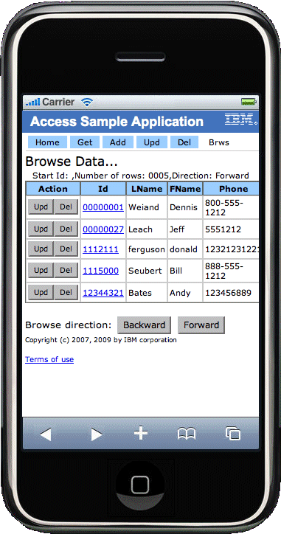
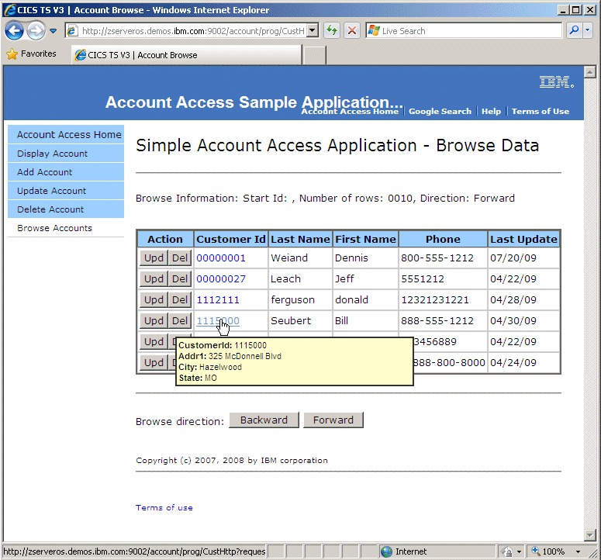
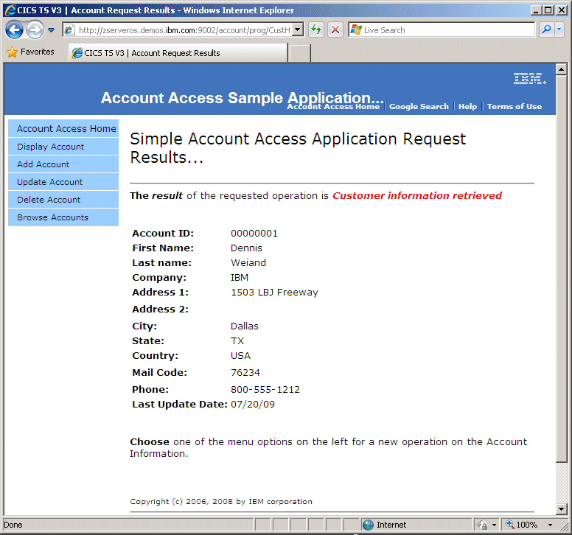
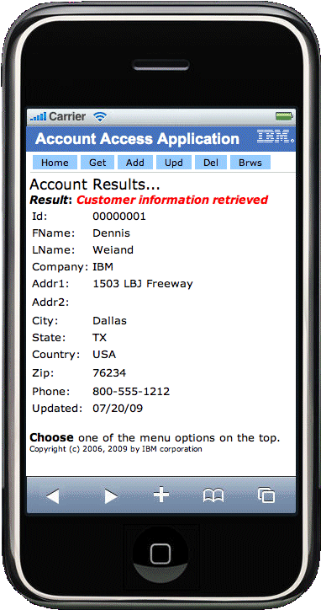
Simple Browser-based Application Interface
From 2005

Slide 27
Notes:
This slide shows a CICS-based application with a simple Web browser interface. Menu options are down the left side for the MS Internet Explorer interface, and across the top for the iPhone-based interface.
All Web browsers send an HTTP header that identifies itself. In this case, the CICS-based application checks to see if the request is coming from an iPhone, and if yes, formats the page to better fit on the Web browser.
For this application, a COBOL program reads the data from a VSAM file and provides the HTML to the Web browser. CICS is also providing the Cascading Style Sheets, the JavaScript, and the graphics.
The Web page shown in MS Internet Explorer.
This also illustrates hover help, also called tool-tips. This is implemented in JavaScript.

Slide 28
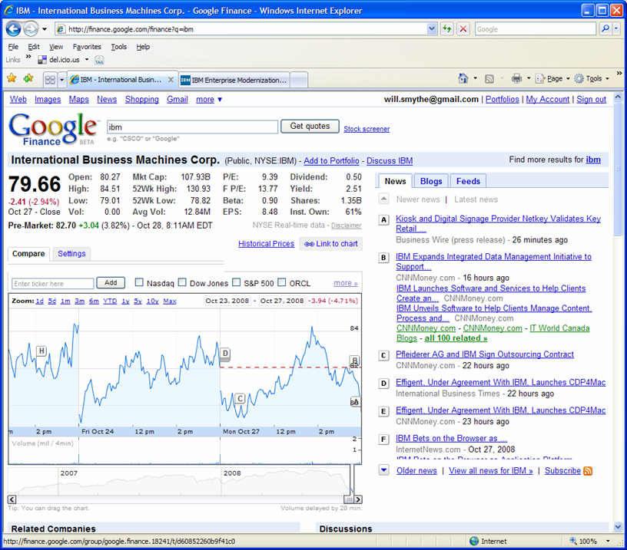
Modern Browser-based Application Characteristics
Rich user experience with minimal page transitions
Dynamic content
Data asynchronously retrieved via REST or SOAP service calls
Client-side validation
User encouraged to add value
Simplified user interface
Integration of relevant data from multiple sources
Commonly referred to as Web 2.0

Slide 29
Notes:
Because of the pervasiveness of the Internet, our approach to serving Web pages has become very refined.
We now try to provide a very rich user experience, providing the user with lots of information. This intent is for the user to require a minimal number of page transition for them to get the information they need to make business decision.
The content of our applications is dynamic with parts of web pages updated as required. The data to update part of a Web page is requested asynchronously usually using REST or SOAP service calls
To provide a very responsive environment to the user, input validation is performed on the client side, in the Web browser.
These design trends are usually referred to as Web 2.0. In addition to being an approach to Web browser page design and interaction, Web 2.0 is also a set of technologies, plus a philosophy on how to interact with our users.
We encourage the user to add value to our Web site by providing feedback and comments, participating in forums, sharing their experiences with the Web site and offering them the opportunity to improve the Web site.
Although the user interface is rich and full-function, the interface is easy to use.
Information from multiple sources is integrated into a single display with the intent of providing the user a rich, enjoyable experience with all the information they need to make business decisions

Slide 30
Web Browser – Associated Technologies
AJAX incorporating: XHTML and CSS, DOM, XML and XSLT, XMLHttpRequest and JavaScript allowing information to be mashed up into new interactive portals.
Rich User Experience
Lightweight Programming Model
XML or JSON data over HTTP, in a lightweight approach sometimes referred to as REST (Representational State Transfer) as an alternative to SOAP.
Info-ware
“DATA is the new HTML." Data management is a core competency of Web 2.0 companies.
RSS/ATOM allows someone access data in such a way as to allow their Web browser to appear to subscribe to the data. Periodic data requests allow for notification when data changes
Feeds
Users must be treated as co-developers, in a reflection of open source development practices. The open source dictum, "release early and release often”
Perpetual Beta (yes, but…)

Slide 31
Notes:
As we move towards providing the user a rich, enjoyable experience with our Web site, we use a variety of technologies.
To move data to and from the Web browser we employ light-weight techniques such as REpresentational State Transfer (REST), which provide for the minimal amount of data sent and received. Data returned to the Web browser is usually in XML or JSON (JavaScript Object Notation).
Just like we link to a Web page to see its current content (state), we reference data in the same way. We specify the target data on the URL. On the URL, the path names the target data, and the HTTP method in the request line indicates the action to be taken on the data.
We also have a need to be notified of changes to data so RSS and ATOM feeds make information readily available with our Web browsers or feed readers periodically checking the information status so they can inform us when the data or data state changes.
User interfaces are changed often to accommodate user requests and to enhance ease of use. The user interface changes often enough in some situations that it is almost like a perpetual beta. However, the business logic and information retrieval logic on servers such as CICS need to remain solid to provide the qualities of service we have always provided in the past.

Slide 32
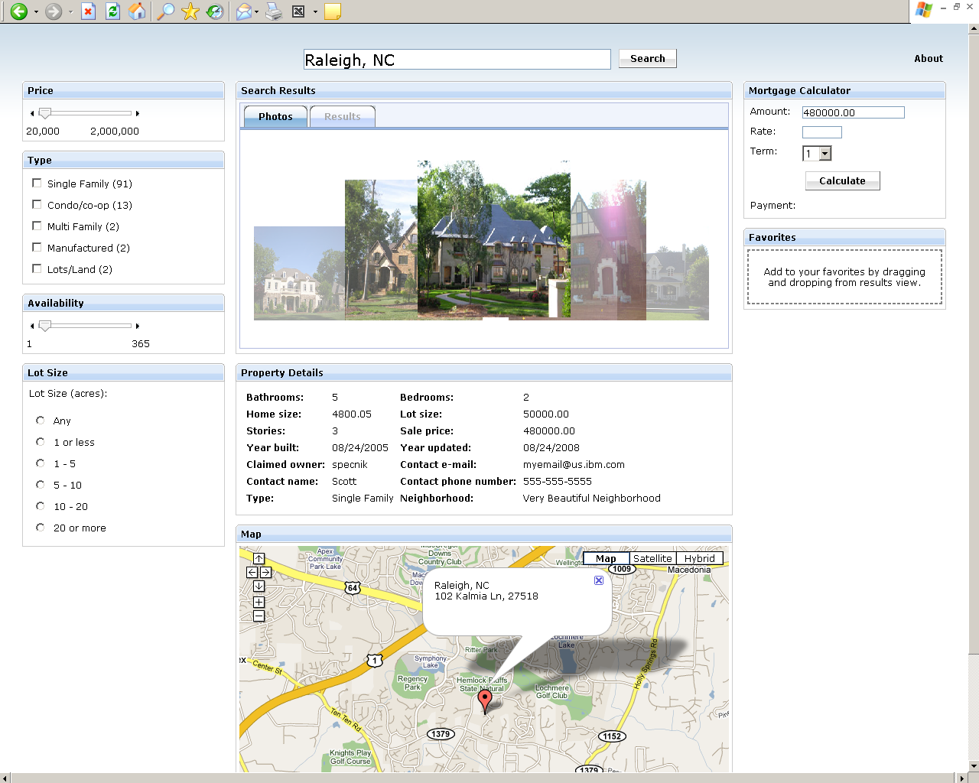
Web 2.0 Style Application
CICS is one of the backend data systems

Slide 33
Notes:
This is a somewhat typical Web 2.0-style user interface. The Web page offers a lot of information to the user, but in a way that the user can easily control the information that is displayed.
This Web page was generated with Rational Business Developer with EGL.
EGL allows the developer to learn one language that can generate code that leverages the common Web 2.0 technologies. Taking this approach allows a developer to become productive faster without taking the time to learn multiple technologies.
Data for this application is retrieved from CICS using Web services.
The design intent is to provide enough information to the user to make a business decision. The user interface should be intuitive.

Slide 34
Search Criteria
Summary Data: flip-photo or tabular
Mortgage widget from bank
Selection Details
Could add: - Comments area - Forum pointers - Government ref for: - Property Taxes - Crime Rates
Filter Data sent in with City request
Map from Google

Slide 35
Notes:
This slide identifies the various areas on the Web page.
On the top, the user can select a city. On the left, sliders, radio buttons, and check boxes are available to filter the properties requested in the indicated city.
The results come back in the center towards the top. The user has the choice of selecting a property by using a flip-photo interface, or if they select the results tab, a table.
Once a property is selected with the flip-photo or via clicking on a table row, the detailed results are displayed in the center of the screen.
A map indicating the location of the property is displayed center-bottom. This map is supplied from another Web site. The results of more than one web site are displayed on this page so the page is considered a ‘mashup’.
On the top-right, a widget is displayed. This small application is a mortgage calculator. The property value to loaded into the mortgage calculator. This Widget could be supplied by a local bank so that getting a loan is only a click away.
Additional items that could be placed on the display is a place for comments, links to forums, links to local government sites to the user can research or display the property tax, neighborhood crime rates, etc.

Slide 36
HTTP Enhancements in CICS TS V4.2
Inbound persistent session throttling
Specify MAXPERSIST on the TCPIPService
NO | 1 – 65535
Outbound Connection Pooling
For CICS Web Support
For CICS Web Services
HTTP Event Processing Adaptors

Slide 37
Notes:
If multiple Web clients set up long-lived persistent connections to CICS as an HTTP server and use the connections heavily, it is possible for a CICS region handling the connections to become overloaded and experience performance problems. If you experience this problem, you can set up connection throttling to make excess Web clients connect to other CICS regions that share the port and provide the same service.
With connection throttling, you can set a limit on the number of persistent HTTP connections that a CICS region accepts for a particular port. If the limit is reached and further Web clients send requests, CICS sends Connection: close headers with each response to require the new clients to close their connection. The Web clients that already have persistent connections to the CICS region can maintain their persistent connections
MAXPERSIST({NO|number})
Specifies the maximum number of persistent connections from Web clients that the CICS region allows for this port at any one time. This setting applies only for the HTTP protocol.
The default value NO means that there is no limit on the number of persistent connections.
In a CICS region that is at risk of being overloaded with persistent connections, you may specify a suitable value (up to a theoretical maximum of 65535) based on the number of persistent connections that the CICS region can handle simultaneously. When this limit is reached and further Web clients connect on the port, CICS requires the new clients to close the connection after they receive each response. When the new clients reconnect, if they connect to another CICS region that shares the port and has not reached its limit, they can maintain a persistent connection there instead. An HTTP/1.1 server should normally allow persistent connections, so only set this option in a CICS region that has experienced performance problems due to persistent connections from long-lived Web clients.
If you specify a value of zero for this option, the CICS region does not allow persistent connections and requires every Web client to close the connection after they receive each response. A zero setting for MAXPERSIST is not compliant with the HTTP/1.1 specification, so only use that setting if you have a special requirement for it in a CICS region that is not currently handling external requests, for example, in a test environment.
By default, CICS closes a client HTTP connection after a CICS application has finished using the connection, or a service requester application has made a Web service request and received a response, or the HTTP EP adapter has emitted a business event. When you set up connection pooling, instead of closing the connection CICS can place the connection in a pool in a dormant state. The dormant connection can be reused by the same application or by another application that connects to the same host and port. Connection pooling can provide performance benefits where multiple invocations of CICS Web support applications, Web services applications, or the HTTP EP adapter make connection requests to a particular host and port, or where a Web services application makes multiple requests and responses.
To set up connection pooling, you specify the SOCKETCLOSE attribute on a URIMAP resource definition for the client HTTP connection. For a client HTTP connection to be pooled, the CICS application program must specify the URIMAP resource on the INVOKE SERVICE or WEB OPEN command, and CICS Web support applications must issue the WEB CLOSE command to explicitly end their use of the connection. A connection cannot be pooled if the server has requested CICS to close the connection, or if the application program has requested the server to close the connection by specifying the CLOSESTATUS(CLOSE) option on the WEB SEND or WEB CONVERSE command. CICS also checks the state of an open connection before placing it in the pool; connections are not pooled if they are found or suspected to be in a poor state, for example, if the last HTTP response was not OK.

Slide 38
More Information
Presentations on CWS (CICS Web Support)
Web Browser Interfaces for CICS applications (in Box folder)
REST Interfaces for CICS applications
Using CWS (CICS Web Support)
ATOM Feeds
Using Servlets
REST, JSON, and z/OS Connect
Corresponding Lab Exercises
L30 – Web Browser Interfaces for CICS applications
L70 & L72 – Servlets and JSPs

Slide 39
Notes:
In the Box folder, you will find a separate presentation on CICS’s Web Support (CWS). The presentation discusses how to access information (from COBOL programs) contained in HTTP requests, and how to provide REST data, static HTML, dynamic HTML, Cascading Style Sheets, JavaScript, and graphics.
The first lab exercise listed (L30) implements a web browser-based application in COBOL.
The third and fourth programs implement the Servlet and JSP APIs available in the Liberty profile (first available in CICS TS V5.1).
The third program implements a simple Servlet using the Java Servlet API.
The fourth program implements a simple Servlet packaged as OSGi bundles.

Slide 40
CICS TCP/IP Connectivity Options
Web Services

Slide 41
Notes:
This section of the presentation covers web services in CICS.
CICS has supported web services since CICS TS V3.1 which became GA on March 25th, 2005. Each release of CICS has had some web services enhancements.
In CICS TS V4.2, Axis2, a Java web service implementation was added and ‘stabilized’ in CICS TS V5.2. It is expected that if you want to use JAX-WS (the Java API for web services) that you will use JAX-WS in the Liberty profile in CICS TS V5.2.

Slide 42
Web Services: Terminology
Architecture for
Application to application
Communication
Interoperation
Definition:
Web Services are software components described via WSDL that are capable of being accessed via standard network protocols such as SOAP over HTTP
WS-I.org (Web Services Interoperability Organization):
An organization to ensure interoperability

Slide 43
Notes:
Web services has the role of a service provider which is some entity that has exposed an available business function.
There is also the role of a service requester which is some entity that would like to consume the business function made available by the service provider.
The service provider and service requester communicate using SOAP (Simple Object Access Protocol) over HTTP (HyperText Transfer Protocol).
WSDL (Web Service Description Language) is used to describe the interface to a business function. The WSDL include the available Business function, what gets passed to the business function, what gets returned from the business function, the protocol (e.g. SOAP over HTTP), and the location of the Web service (also called the endpoint.
CICS supports both SOAP over HTTP and SOAP over WMQ.
Initially, most people thought the primary use of Web services would be to do business over the Internet. Today, the primary use of Web services is to provider interoperability between business entities within a company. In an Internet-based Web service environment. Information about Web services are often placed in a business registry. This is similar to a telephone book. Potential users of the business function can do a ‘lookup’ in the business registry and ‘find’ someone that offer the business function they need. They can solicit the interface to the business function in question, so they can start doing business with that business using SOAP over HTTP.
The WS-I (Web Service Interoperability Organization) was formed by over 170 companies to ensure everyone interprets the Web service standards the same way and that we really do achieve the interoperability that Web services promises.
We, in the IT industry, have tried several techniques to interoperate in that past. This time around, everyone is agreeing on a single set of standards.

Slide 44

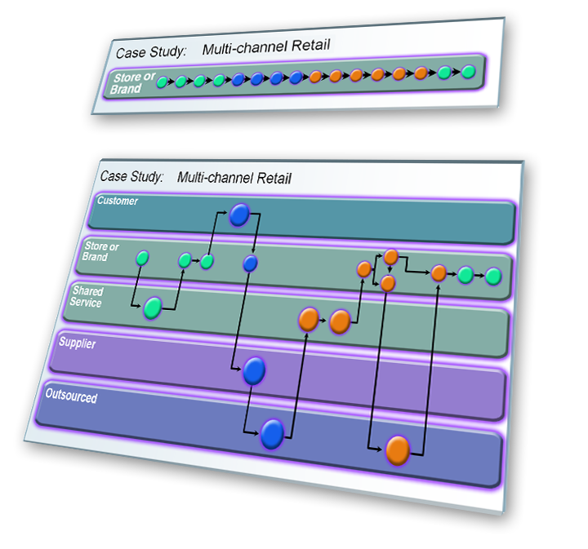
Associated technology: Service Oriented Architecture
Reuse of Services (encapsulated Business functions)
Align with Business process to respond faster to Business needs
Compose new applications by combining Services
SOA Levels
Service Enablement - Transform existing applications to services
Service Integration –Align with business, abstract integration layer, look into ESB
Process Integration – Composite applications with process choreography and service aggregation

Slide 45
Notes:
Although Web service can be used as just a way to transport information from program A to program B, most people pursue Web services as an avenue to progress towards a Service Oriented Architecture (SOA).
With SOA, you decide on your companies business functions and their interfaces and then provide a technical implementation of the business functions.
If you align your services with your business functions, you will be able to use the services as building blocks to adjust your currently applications quickly and to quickly address new business opportunities. With 7 of 10 computing dollars spend on application maintenance, the agility and flexibility of SOA is important.
Since it is unlikely that you can convert to an SOA quickly, most people consider SOA in levels.
You will want take your existing CICS assets and expose them as Web service, but plan ahead since the most benefit will be gained from an SOA when you align your Web services with your business processes.
To gain the most flexibility, you will want to look into Process Choreography with a tool such as IBM Integration Designer and IBM Business Process Manager.
IBM Integration Designer is a graphic development environment where you can drag-and-drop business functions on a canvas to construct a new application. You draw lines between the business functions to show the flow of data between business functions in your application.
IBM has offerings, some free, that you can leverage to help you move to an SOA.

Slide 46
CICS as a Web Service Provider
CICS TS
Service Provider
CICS
Web Services
Support
Service Requester
Business
Logic
Program
Language
structure
0101001
Client Application
SOAP Message - XML, tag delimited data, one body, zero or more headers
zero or more headers
body containing application data
Languages Structure – e.g. COBOL copybook
01 DFHCOMMAREA. 03 CUSTOMER-FIRST-NAME PIC X(30). 03 CUSTOMER-LAST-NAME PIC X(30). …

Slide 47
Notes:
CICS provides assistance when creating web services and can allow you to expose existing CICS programs as web services.
The approach can be to interface with a COMMAREA or channel and container-based program, or, in the CICS TS V4.2+, you can stay completely in a Java environment within CICS for web services. More will be discussed on this later.

Slide 48
CICS as a Web Service Provider
CICS TS
Service Provider
CICS
Web Services
Support
Service Requester
Business
Logic
Program
Language
structure
0101001
Client Application
Since CICS TS V3.1 - CICS parses SOAP request into a COMMAREA or Channel and Containers - Since V4.1, Initial general parse is zAAP eligible - Field level parse can be zAAP eligible if using RDz
Any CICS-supported programming language
Batch utilities provided with CICS (or use RDz) to generate or start with either a copybook or WSDL

Slide 49
Notes:
We will have a detailed discussion on web services later, but his slide contains a few of the details behind web services in CICS.

Slide 50
Web services: Tooling
CICS Web Services Assistant
Batch utilities
IBM Developer for System z (IDz)
Eclipse-based
Additional language constructs supported
Can generate COBOL converter program with PARSE verb
Can be zAAP eligible
Both allow for the various development styles
Top down
Bottom up
Meet in the middle
Can also invoke web services and can also return faults
EXEC CICS INVOKE SERVICE, and EXEC SOAPFAULT CREATE

Slide 51
Notes:
Development options for web services in CICS
These will be discussed in detail in a later presentation

Slide 52
Web services: CICS TS Web Service Standards Support
Both HTTP and WebSphere MQ network layers supported
HTTP 1.0 and 1.1 supported
CICS applications acting as providers or requesters are agnostic to transport mechanism used
XML Encryption Syntax and Processing interoperability with entities using XML
XML Signature Syntax and Processing interoperability with entities using XML
SOAP 1.1 and 1.2 to send and receive Web services messages
WSDL 1.1 and 2.0 to describe Web service interfaces (WSDL 2.0 in TS 3.2)
WSDL 1.1 Binding Extension for SOAP 1.2 for Interoperability with interfaces
WS-I Basic Profile 1.1 for interoperability between providers and requesters using SOAP
WS-I Simple SOAP Binding Profile 1.0 for interoperability using SOAP
WS-AtomicTransaction for propagating transactional context
WS-Coordination for coordinating transaction outcome
WS-Security for authentication and encryption of all or part of a message (PK22736) username token profile 1.0, X.509 Certificate Token
WS-Trust for establish trust relationships (in TS 3.2)
MTOM / XOP for efficient handling of large messages (in TS 3.2)
SOAP 1.1 Binding for MTOM 1.0 to describe the use of MTOM (in TS 3.2)
WS-Addressing to indicate request and response routing (in TS 4.1)

Slide 53
Notes:
This is a list of the Web service-related specifications that CICS supports.
More details on these during the Web services-specific presentation at this Workshop.

Slide 54
More Information
Will be a separate presentation on CICS’s Web Service Support
How CICS processes Web Service requests
How to create Web Services
Corresponding Lab Exercises
L20 – CICS Web Services Assistant - basic
L21 – CICS Web service – RDz, bottom-up, compiled
L22 – CICS Web service – RDz, Meet-in-middle, Interpretive
L23 – CICS Web service – RDz, Meet-in-middle, compiled
L24 – CICS Web service – CICS as a Requester
L27 – Multiple Containers – Mapping level 3.0

Slide 55
Notes:
Later in the workshop there will be a presentation on CICS’s Web Service Support. The presentation will discuss how CICS processes Web service requests, and how to expose your application programs as Web services.
Several Lab exercises are available in the CICS Web Service; they are listed on the slide.

Slide 56
CICS TCP/IP Connectivity Options
REST Services

Slide 57
Notes:
This section of the presentation discusses REST (REpresentational State Transfer).

Slide 58
REST Services
Similar in concept to hyperlinked data
Lightweight data transfer
Representational State Transfer
Nouns (URLs) indicate what is being worked on
Verbs (GET, PUT, POST, DELETE) indicate the action to be performed (List, Create, Read, Update, Delete)
Format of results is not defined
Popular formats of returned data are XML and JSON
Can use EXEC CICS TRANSFORM for XML parse/create
Recent CICS feature for creating JSON
Approaches in CICS
CICS WEB API
ATOM Feed
Servlet and JSP (Liberty Profile)
JAX-RS (Liberty Profile)

Slide 59
Notes:
REST (REpresentational State Transfer) is an architectural style that applies the approach we use to access Web pages to access our business data. Just like we use a URL to access the current state of a Web page, you use a URL to access the current state of business data. We can specify a specific Web page on a URL, we can also specify a specific account number on a URL.
We normally need to perform LCRUD (List, Create, Read, Update, and Delete) functions on our business data. The HTTP ‘methods’ that flow with the request indicate the action to be performed on the data. Whereas we normally only use a GET or a POST method when accessing a Web page, for data, a GET method indicates a list or a read, DELETE for a delete, POST for an add, and a PUT for an update.
REST results in very lightweight interactions with a minimal amount of characters transferred.
The format of the returned data is not dictated, although most people use XML or JSON (JavaScript Object Notation.
REST is documented in Roy Fielding’s year 2000 doctoral thesis. In his thesis, Fielding indicates that REST started in 1994 and was iteratively redefined. Since many people were not aware of REST, they think it is a follow-on to Web services, however Web services came after REST.
For situations where you want interfaces documented with WSDL, transactionality, and more security options, Web services are great. Where you just need lightweight data access, REST is great.
One of the primary uses of REST is for requests from Web browsers. JavaScript running in a Web browser can use AJAX (Asynchronous JavaScript and XML) to make RESTful requests to backend data and business logic systems such as CICS.
The easiest ways to expose business data or business logic in CICS as RESTful services is use of the CICS WEB API, ATOM feeds. These will be discussed in upcoming slides.

Slide 60
REST Service Requests
Request URI | HTTP Method | Event
Collection URI, e.g.: http://xyz.com/prefix/myResource
Member URI, e.g.: http://xyz.com/prefix/myResource/resourceID
GET
POST
PUT
DELETE
List
Create
GET
POST
PUT
DELETE
Retrieve
update
delete

Slide 61
Notes:
This illustrates the relationship between the URL, the HTTP method, and the action to be taken on the data.
For example, if the URL was http://www.books.are.us/JKRowling with a GET method, you would be asking for a list of books written by J. K. Rowling.
If the URL was http://www.books.are.us/JKRowling/HarryPotterAndThePhilosophersStone with a GET method, you would be asking for details on the first book in the Harry Potter series.
As you can see, REST style requests are lightweight.

Slide 62
REST Simple Sample
Request
Response
GET /mortgage/231677 HTTP/1.1
Host: www.example.com
Accept-Language: en
Charset: UTF-8
HTTP/1.1 200 OK
Language: en_us
Charset: UTF-8
Content-Type: text/json
{“principal”:”238000”,”rate”:”3.5”, “type”:”5/1 ARM”}
or
HTTP/1.1 200 OK
Language: en_us
Charset: UTF-8
Content-Type: text/xml
<mortgage><principal>238000</principal><rate>3.5</rate><type>5/1 ARM</type></mortgage>

Slide 63
Notes:
This page illustrates the flow of data ‘on the wire’ for a REST request.
The samples include the HTTP (HyperText Transfer Protocol)
The request starts with an HTTP request line (“GET /mortgage/231677 HTTP/1.1”) followed by HTTP headers that define additional characteristics of the transmission.
The request indicates that we would like the details on mortgage 321677
Since the most popular way of returning information is via XML or JSON, we have shown an example of each.
In both situations there is an HTTP response line indicating the status of the request plus HTTP headers indicating the type, language, and codepage of the request (you may see additional header information). In the body of the HTTP transmission is the application data either in XML or JSON notation.
Some people feel that JSON has less characters to transfer and is easier to parse so it is a popular format.
REST services can be implemented in CICS using the CICS WEB API, using ATOM feeds, and using Servlets/JSPs.

Slide 64
More Information
REST is covered in the REST, JSON, and z/OS Connect presentation
Related presentation:
Web Browser Interfaces for CICS applications (which includes the CWS commands that can be used to create a REST service) (in Box folder)
ATOM Feeds in CICS (in Box folder)
Lab Exercises
L45 – ATOM Feeds in CICS
L90 & L91 – REST applications using CICS JSON support
L93 – JAX-RS
L97 – z/OS Connect

Slide 65
Notes:
There isn’t a separate presentation on ‘REST’ in this workshop, but there are presentations on the three easiest ways to expose information as a REST service;
CICS Web Support (in the presentation on Browser Interfaces to CICS applications)
ATOM Feeds in CICS
The slide list the lab exercises that are available when creating REST interface to CICS-based applications.

Slide 66
CICS TCP/IP Connectivity Options
JSON Support

Slide 67
Notes:
This section discusses CICS’s JSON support

Slide 68
JSON (JavaScript Object Notation)…
JavaScript Object Notation
Data in attribute-value pairs
Used primarily to transmit data between a server and web application
Alternative to XML
Originally based on JavaScript –
Most commonly used in web browsers
Dynamic computer programming language
JSON MIME type
Official: “application/json”
Unofficial: “text/json” or “text/javascript”

Slide 69
Notes:
JSON acronym was coined by State Software ~2001
The JSON.org web site was launched in 2002
Although JSON is commonly perceived as being a subset of JavaScript, it allows some unescaped characters in strings that are illegal in JavaScript.
JSON is language-independent (although JSON was originally based on a non-strict subset of the JavaScript scripting language (ECMA-262 3rd Edition – December 1999 ) )

Slide 70
JSON (JavaScript Object Notation)…
Attribute-value pairs (example of JSON) { "id": 1, "name": "Foo", "price": 123, "tags": [ "Bar", "Eek" ], "stock": { "warehouse": 300, "retail": 20 } }
Info about JSON schema: http://json-schema.org/
Info about JSON schema core definitions and terminolgy: http://tools.ietf.org/html/draft-zyp-json-schema-04
Info about JSON schema interactive and non-interactive validation: http://tools.ieft.org/html/draft-fge-json-schema-validation-00

Slide 71
Notes:
On the top of the prior page is an example of JSON with its attribute-value pairs.
The bottom half of the prior page list some web sites where you can get the details.

Slide 72
JSON (JavaScript Object Notation)…
Can be requested from a web browser using AJAX (Asynchronous JavaScript And XML)
var my_JSON_object; var http_request = new XMLHttpRequest(); http_request.open("GET", url, true); http_request.onreadystatechange = function () { var done = 4, ok = 200; if (http_request.readyState === done && http_request.status === ok) { my_JSON_object = JSON.parse('''http_request.responseText'''); } }; http_request.send(null);

Slide 73
Notes:
This list the most common usage of JSON… an AJAX request from a web browser.
Recently there has been interest in JSON as a data format requested between programs. This is probably due to all the rules around web services, plus JSON generally conveys less characters.

Slide 74
JSON with CICS TS
CICS native support for JSON—delivered in V5.2; use Feature Pack for CICS TS V4.2 and V5.1. (all languages supported in CICS)
JAX-RS and JSON4J (in the Liberty Profile) (Java)
CICS Transaction Gateway (inbound only)
zOS Connect
Running in a stand-alone server (WOLA or IPIC to CICS)
Build toolkit, API toolkit

Slide 75
Notes:
There are several ways to handle JSON with CICS TS
The Mobile Feature Pack for CICS – offers JSON conversion to/from copybook or data structure in several CICS-based languages
JAX-RS and JSON4J are available with coding in a CICS-Java program running in a Liberty Profile under CICS
CICS support PHP which has a json_encode and a json_decode function
The latest version of the CICS Transaction Gateway can take JSON in and execute a CICS-based program
zOS Connect currently can be used in WebSphere Application Server or a Liberty Profile
It then uses WOLA to communicate to CICS
There are more scenarios planned for z/OS Connect

Slide 76
JSON in CICS TS
JSON support in CICS:
JSON web services
Bottom-up – start with a copybook
Request-response (aka RPC) style service only
Top down – start with a JSON schema
Request-response style service
RESTful style service
JSON Transformer Linkable Interface (callable)
Bottom up – start with a copybook description and generate the ‘transforms’ to have a JSON string in a program converted into a copybook (and vice versa)
Top down – start with a JSON schema and generated the ‘transforms’ to have a JSON string in a program converted into a copybook (and vice versa
In the Liberty profile (JAX-RS and JSON4J) (Java)

Slide 77
Notes:
In addition to the top-down scenario on the previous page using the CICS Mobile Feature Pack, you can also use the feature pack in a bottom-up scenario, plus the JSON transformer has a linkable interface.
As a reminder, you can also use PHP in CICS or Java in CICS to encode or decode JSON

Slide 78
More Information
JSON is covered in the REST, JSON and z/OS Connect presenatation
Corresponding Lab Exercises
L90: Native JSON Request-response service
L91: Native JSONRESTful JSON service
L93: REST services using JAX-RS
L97: z/OS Connect

Slide 79
Notes:
Soon we will have a separate presentation on CICS’s JSON support.
Currently there are no lab exercises on JSON.

Slide 80
CICS TCP/IP Connectivity Options
ATOM Support

Slide 81
Notes:
This section discusses CICS’s ATOM support

Slide 82


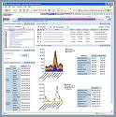

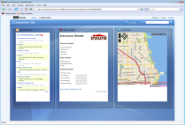
CICS ATOM Support…
Example High level architecture: CICS Atom feeds
z/OS
Enables CICS applications to:
Provide live information for Web 2.0 consumption
Integrate with related data
Give full picture in a single holistic view
Create new applications based on up-to-date content and information
Decision-support tools for knowledge workers
Composite user interfaces for expert workers
Information feeds & widgets to consumers for use in their own mashups
CICS
Transaction
Server
DB2 for
z/OS
ATOMSERVICE
Customers
&
Insurance
Policies
Unix
Atom feeds
IBM Lotus
Mashups
Server
Servlet
Map API
PC
Browser

Slide 83
Notes:
Business users can take advantage of CICS Atom feeds to quickly create mashups, Web 2.0 applications that pull information from a variety of sources and aggregate it into a single, dynamic application. Businesses can exploit mashup technology in a variety of ways, including these four:
Create decision-support tools for knowledge workers who require access to a variety of commercial and public, structured and unstructured, data and content.
Build composite, dynamic user interfaces for workers whose daily activities involve accessing data and functions in multiple, disparate applications and systems.
Make new location-aware applications combining enterprise data with presence information from mobile providers and mapping and geo-spatial information from third parties.
Deliver information feeds and widgets to consumers to use in their own mashups.

Slide 84
CICS ATOM Support…
An Atom Feed is a standards-based protocol and XML format for content publishing
Provide XML-based feed of updated content
Process is known as syndicating a feed
Follow-on to Real Simple Syndication (RSS)
Simple publish/subscribe implementation
Polling model
CICS TS
VSAM File
HTTP Client usually a Web Browser or Feed Reader
CICS ATOM Support
TS Queue
XML-based standardized format and content, with a REST interface
Program

Slide 85
Notes:
Atom is both a protocol and an XML format for content providers to provide XML based web feeds of updated content. An Atom feed is a web feed provided using the Atom protocol and format. This provision of updated content is known as syndicating a web feed. Web users can subscribe to a feed allowing them to see new content as soon as it is made available.
Atom is described by two proposed standards defined by two Internet RFCs. Consult the following RFCs for complete, and authoritative, information about Atom.
The Atom Syndication Format
The Atom Publishing Protocol
CICS’s Atom support allows you to quickly expose a File, a TS queue, or an application program as an Atom feed.

Slide 86
Example Atom 1.0 Feed
<?xml version="1.0" encoding="utf-8"?> <feed xmlns="http://www.w3.org/2005/Atom"> <title>Example Feed</title> <subtitle>A subtitle.</subtitle> <link href="http://example.org/feed/" rel="self"/> <link href="http://example.org/"/> <updated>2010-12-13T18:30:02Z</updated> <author> <name>John Doe</name> <email>johndoe@example.com</email> </author> <id>urn:uuid:60a76c80-d399-11d9-b91C-0003939e0af6</id> <entry> <title>Atom-Powered Robots Run Amok</title> <link href="http://example.org/2010/12/13/atom03"/> <id>urn:uuid:1225c695-cfb8-4ebb-aaaa-80da344efa6a</id> <updated>2010-12-13T18:30:02Z</updated> <summary>Atom Robots: Watch Out</summary> <content><name>Joe</name><date>2011-04-29</date></content> </entry> </feed>

Slide 87
Notes:
This example data sent back in an Atom 1.0 feed

Slide 88
CICS ATOM Support
URIMAP definition
ATOMSERVICE definition
Describes the type of Atom document returned
FEED, SERVICE, COLLECTION, CATEGORY
Specifies the type of CICS resource that provides the data for this Atom feed or collection
FILE, PROGRAM, TSQUEUE
Atom Service Configuration file
Specifies metadata/field names for the returned document
XML Binding file
Describes the CICS resource format
CICS TS V4.2+ – allows you to package definitions in a CICS BUNDLE, tooling for building ATOM Feeds provided in the CICS Explorer
http://mycics.hursley.ibm.com/atom/cicsq/zem
<cics:atomservice type="feed"
</cics:atomservice>
URIMAP
PATH(atom/*)
USAGE(ATOM)
ATOMSERVICE
CONFIGFILE(zem)
BINDFILE(ztsq)
ZTSQ Bind File

Slide 89
Notes:
The new ATOMSERVICE resource definition defines an Atom service, feed, collection, or category document, and identifies the Atom configuration file, CICS resource or application program, and Atom binding file that are used to supply the data for the feed. URIMAP resource definitions handle the incoming requests and point to the appropriate ATOMSERVICE resource definition.
The Atom configuration file contains XML that specifies metadata and field names for the Atom document that is returned for this resource definition.
The XML binding file specifies the data structures used by the resource named in RESOURCENAME, which supplies the data for the Atom document that is returned for this resource definition. You create an XML binding file using the CICS XML assistant program DFHLS2SC.

Slide 90
CICS ATOM Support
CICS BUNDLE
http://mycics.hursley.ibm.com/atom/cicsq/zem
<cics:atomservice type="feed"
</cics:atomservice>
URIMAP
PATH(atom/*)
USAGE(ATOM)
ATOMSERVICE
CONFIGFILE(zem)
BINDFILE(ztsq)
ZTSQ Bind File
ATOM-related definitions and config file packaged in a CICS BUNDLE
CICS Explorer includes tooling to build artifacts
Create the BUNDLE and BUNDLE manifest
Editor for the Atom configuration file

Slide 91
Notes:
CICS TS V4.2+ you can work with ATOM feeds even easier by allowing you to package the Atom-related artifacts in a CICS BUNDLE, and providing tooling in the CICS Explorer to create the BUNDLE and edit the configuration file.
In CICS TS V4.2+, the TRANSACTION name and USERID can be specified in the configuration file.

Slide 92
More Information
Separate presentation on Atom Feeds in CICS in the Box folder
Corresponding Lab Exercises
L45 – CICS Explorer Atom wizards with bundles

Slide 93
Notes:
In the Box folder is a separate presentation on CICS’s Atom support.
This slide lists the lab exercises that are currently available in this workshop on CICS’s Atom support.

Slide 94
CICS TCP/IP Options – Related Technology
Java Servlets and JSPs

Slide 95
Notes:
These slides discuss CICS’s support of the Java Servlet and JSP specifications

Slide 96
JV Servlets and JSP support…
CICS V5.1+
JVM server
Liberty
HttpRequest
URIMAP
Tranid
Web Application
Web Client
HttpResponse
SEC=YES
web.xml <security_constraint>
Standard Java APIs (Servlet, JSP, JDBC)
Supports much of the Liberty Profile
Can use the JCICS API or EXEC CICS LINK to a program in any language

Slide 97
Notes:
CICS Servlet and JSP support is an implementation of the WAS Liberty Profile.

Slide 98
Java Servlets and JSP support…
Supports Java servlets and JavaServer Pages (JSPs) and RESTful clients, connectivity to DB2 (type 2 driver)
CICS TS also supports distributed transactions, a type 4 JDBC driver, and Liberty security
CICS’s support built on the WAS Liberty profile technology
Highly configurable
Can use the JCICS and JCICSX classes along with JEE 8 and 9 and Spring Boot framework.
Can use Eclipse, Rational Application Developer (RAD), and IBM Developer for System z (Idz) as well as other IDEs to develop servlets and JSPs
Define BUNDLE resource for your application
Several samples

Slide 99
Notes:
CICS Servlet and JSP support is an implementation of the WAS Liberty Profile.

Slide 100
CICS Servlets and JSP support
Uses Java 8+ (64-bit)
Can use CICS basic authentication
Can run under Liberty security
By default, task runs under the CJSA transaction
Can add a URIMAP and TRANSACTION resource to a CICS bundle if you want to run under a specific transaction

Slide 101
More Information
Corresponding Lab Exercises
L70 – Using Servlets and JSPs with CICS
L72 – Servlets and JSPs with LINK to COBOL

Slide 102
Notes:
Later in the workshop there will be a separate presentation on CICS Servlets and JSPs
This slide lists the lab exercises that are currently available in this workshop on CICS Servlets and JSPs

Slide 103
CICS TCP/IP Connectivity Options
CICS Transaction Gateway, Sockets, and IPIC

Slide 104
Notes:
This section talks about
CICS Transaction Gateway
Enterprise JavaBeans
Sockets
IPIC

Slide 105
CICS Transaction Gateway
Enabler for the Java Connector Architecture (J2C)
Using C, C++, C#, VB, COBOL on workstation
COMMAREA or channel and containers
Supported with any JEE 1.4 or higher compliant application server
SNA or TCP/IP (ECI, IPIC) to CICS
WAS
CICS TG
CICS TS
Servlet, JSP, EJB
J
2
C
CICS Program
CICS Transaction Gateway
Business logic
Applet, Any Java Pgm
J
2
C
B
Many Languages, Many Platforms
WAS=WebSphere Application Server

Slide 106
Notes:
Capabilities
Enabler for J2C (Java Connecter Architecture)
Synchronous
Inbound to CICS only
COMMAREA or channels and containers
CICS TG daemon runs on many platforms
Highly optimized, very fast
Security to zSeries
SSL to CICS TG daemon
Userid and trusted relationship from CICS TG daemon to CICS TS
Transactional scope
2-PC (XA resource) when using IPIC to CICS TS V3.2 and above
2-PC (XA resource) when CICS TG daemon on z/OS
2-PC (last participant support with WAS V6 and above)
1-PC when CICS TG daemon on a distributed platform not using IPIC
Interface
J2C = Java (CICS TG daemon)
Other languages
COMMAREA or channels and containers
ASCII to EBCDIC performed on client or CICS (System z)
With CICS TG V9.1, it will transform JSON inbound and invoke a COMMAREA or channel and container-based CICS program
Communications
SNA or TCP/IP (ECI, TCP/IP)
Tools
Can generate J2C capable object to use the CICS TG from Rational Application Developer (RAD), IBM Integration Designer, or Rational Developer for System z (RDz)

Slide 107
TCP/IP Sockets
e-business client
CICS TS
A
TCP/IP
CICS Sockets listener
Child server
Message adapter
B
D
CICS Sockets provides a completely programmable solution where other access options are not suitable
Support for sockets is provided by Communications Server

Slide 108
Notes:
Sockets support in CICS provides for low-level integration for situations where the target system does not support a higher-level TCP/IP-based communications standard or for situations where the only consideration is speed.
Although sockets can provide great speed, sockets coding normally requires additional effort by the application programmer since the application program is responsible for every communications interaction.
There is no built in way to propagate a security or transactionality context.
Support for Sockets in CICS is provided IBM Communications Server.

Slide 109
CICS & MQ Connectivity Options
The messaging Interface to CICS
MQ Attachment Facility
MQ DPL Bridge
MQ as a Web service transport
Can be a transport for CICS Events

Slide 110
WMQ Interoperability Options
e-business client
CICS TS
JMS
A
WebSphere MQ
WebSphere MQ trigger monitor
MQ API
Message adapter
B
D
e-business client
CICS TS
A
Message adapter
WebSphere MQ DPL bridge
B
D
WMQ
WebSphere MQ
Assured asynchronous message delivery
MQ DPL bridge links to existing CICS programs
Web service transport, Event transport
MQ calls are threadsafe
Group Attach and Group unit of recovery

Slide 111
Notes:
WMQ has been a CICS connectivity option for quite some time
WMQ has assured asynchronous message delivery
Messages can be very large
A feature called the MQ DPL bridge allows you to place a COMMAREA-like message on a queue. CICS reads the queue item and uses it as a COMMAREA when it links to a specified CICS programs. Using this approach, the CICS application programmer doesn’t need to know the WMQ API; their application program gets invoked as if it was LINKed to by another CICS program.
Can be used as a transport for CICS Events
Can be used as a Web service Transport
CICS TS V3.2 added WMQ to OTE (CICS’s Open Transaction Environment). When a CICS-based application program is specified as ‘threadsafe’ or ‘open api’, the WMQ get and put commands are processed on an L8 TCB. This can greatly reduce TCB switching, thereby improving throughput and response time by lower required CPU cycles.
CICS TS V4.1 added Group Attach – CICS can communicate with a single queue manager from a group
CICS TS V4.2: able to attach to any local WMQ server in the queue sharing group and have it resolve outstanding UOWs. Requires WMQ queue managers have GROUPUR attribute
CICS TS TS V5.1 you can pass a container with the WebSphere MQ DPL Bridge

Slide 112
IPIC Interoperability
CICS TS – V3.2+
CICS TG V7.1+
CICS TS IPIC Interoperability
DPL (V3.2+)
Business Function
CICS TS V3.2+ - IPIC
Business Function
(V4.1+) – Txn Routing - Function Shipping of START and CANCEL
P
I
B
D
P
I
B
D
(V4.2+) – Threadsafe mirror, function ship file control and TS
IPIC communications initially added in CICS TS V3.2
Provides DPL between CICS regions (V3.2 or higher)
Provides transaction routing and Function Shipping of START and CANCEL requests between CICS regions (V4.1 or higher)
CICS TS V4.2: Threadsafe mirror, function shipping of file control and TS
Can be used with CICS Transaction Gateway V7.1 or higher
Allows for channels and containers communications between CICS TG and CICS

Slide 113
Notes:
IPIC communications was initially added to CICS TS V3.2.
This type of communications can be used in conjunction with the CICS Transaction Gateway V7.1 or higher
Provides a full two-phase commit
Provides for channels and containers communications
RAD V8.5.1 (Rational Application Developer) and RDz V8.5.1 (Rational Developer for System z) provides wizards that, based on COBOL data structures, can generate Java classes that use channels and containers for communication
RAD and RDz have both been able to generate Java classes that use COMMAREA communications for several releases
At CICS TS V3.2, IPIC communications is available for region-to-region DPLs (Distributed Program Link)
CICS TS V4.1 extended IPIC communications to allow for region-to-region transaction routing
CICS TS V4.1 extends TCP/IP communications to include IPv6
CICS TS V4.2 add a threadsafe mirror
CICS TS V4.2 provides function shipping of file control and TS requests

Slide 114
CICS SNA Options
SNA (Systems Network Architecture) has been available in CICS for several releases
SNA is mature and stable
CICS will enhance IPIC where it makes sense.

Slide 115
Notes:
This section discusses the SNA connectivity options

Slide 116
SNA Interoperability Options
CICS TS
CICS TG
CICS TS SNA Interoperability
LU6.2/LU6.1
Business Function
3270
P
I
B
D
CICS TS - SNA
Business Function
P
I
B
D
SNA (Systems Network Architecture has been around a long time, is very mature, and very stable). It can be used for…
Region-to-region communications
CICS Transaction Gateway
LU6.2 and LU6.1
SNA-based 3270 devices

Slide 117
Notes:
SNA (Systems Network Architecture has been around a long time, is very mature, and very stable). It can be used for…
Region-to-region communications
CICS Transaction Gateway
LU6.2 and LU6.1
SNA-based 3270 devices
Since SNA is stable, CICS will be enhancing IPIC where appropriate

Slide 118
Notes:
This section talks about CICS Interoperability with WMQ

Slide 119
CICS Event Processing
Provide information relevant to your business processes to a variety of systems
IBM Operational Decision Manager
WebSphere Business Monitor
Emit to WMQ queues or via HTTP
CICS-based transactions and programs
User-written programs
Receiving system analyzes business information from one or more sources and takes appropriate action

Slide 120
Notes:
This section contains slides on Event processing in CICS

Slide 121
Event Processing…
An event is something that happens that is relevant to the business
“simple” event: meaningful in itself (not an aggregation of information)
Order placement, stock trade
“complex event processing”: detect and respond to patterns of events
3 orders from a customer in 2 days, suspicious pattern of ATM activity
“Business Event Processing” extends event processing capabilities to business users
CICS can be significant source of events
Focus is on events relevant to the Line-of-Business
CICS emits single events
Events emitted by CICS could
Drive another CICS transaction
Be written to a temporary storage queue
Be input to a monitor or business manager’s dashboard
Be sent to a “complex event processing” engine such as IBM Operational Decision Manager
Can be business events (CICS TS V4.1+)
System events (CICS TS V4.2+)

Slide 122
Notes:
You can specify, capture, and emit business events from a CICS® application. These business events can be consumed by another CICS application, or placed on a WebSphere MQ queue for consumption in a variety of ways including by a complex event processing engine such as IBM Operational Decision Manager.
A business event is anything that happens that is relevant to your business. An individual stock trade or the placement of an order are both examples of business events. CICS allows business events to be captured in an application and emitted for processing, with typically no change to the emitting CICS application.
After CICS has captured and processed a business event, it is passed to an EP (Event Processing) adapter for formatting and routing. CICS provides EP adapters to allow business events to be emitted to WebSphere MQ, either in XML format for consumption by WebSphere Operational Decision Manager, in CBE (Common Business Event) XML format to the Common Event Infrastructure (CEI) for consumption by business monitors, or in a non-XML character format, as well as to a CICS transaction or to a CICS temporary storage queue.
You can also write your own custom EP adapter. CICS supports custom EP adapters written in the following languages:
COBOL
PL/I
C
C++
IBM Assembler

Slide 123


Event Processing…
Development and Deployment Tools
(CICS Explorer or RDz)
IBM Operational Decision Manager
Existing Business Logic
CICS Event Processing
Event Capture
Filtering
Enrichment
Formatting
Routing
Extensible
Secured
Monitored
etc.
WebSphere Business Monitor
CODE NOT CHANGED
Or
Add EXEC CICS SIGNAL EVENT
Captured
Events
Events
Other Event Consumers
CICS TS V4+

Slide 124
Notes:
An overview of event processing in CICS.

Slide 125
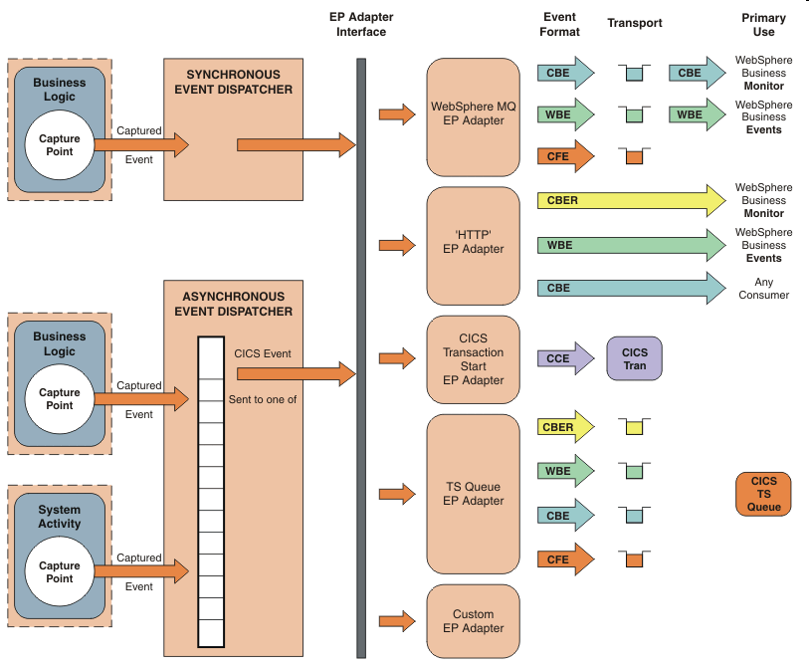
Event Processing
CICS TS V4.2 ➔
CICS TS V5.1 ➔
PK94205
CICS TS V4.1 ➔
CICS TS V4.2 ➔
CICS TS V5.1 ➔
CICS TS V4.2
CICS TS V4.2 ➔
CICS TS V5.1 ➔
You can have multiple Adapters in V5.1

Slide 126
Notes:
A CICS application can capture and emit business events with no change to the application itself, using noninvasive capture points, before and after selected EXEC CICS API calls, and at program start.
For situations in which the noninvasive capture points are not sufficient to capture a specific business event, a new EXEC CICS API call, SIGNAL EVENT, allows events to be captured anywhere in a CICS application.
The CICS Explorer includes the CICS event binding editor, a tool that helps you to define simple business events and create event bindings for your CICS applications. You deploy event bindings to a CICS system from the CICS Explorer.
After CICS has captured and processed a business event, it is passed to an EP (Event Processing) adapter for formatting and routing. CICS provides EP adapters to allow business events to be emitted to a TS Queue, to a Transactions (CICS can do a start with data), or using WebSphere MQ. When generating Events to WebSphere MQ, events can be in XML format for consumption by IBM Operation Decision Manager, in CBE (Common Business Event) XML format to the Common Event Infrastructure (CEI) for consumption by business monitors, or in a non-XML character format known as CFE. The CFE format (CICS Flattened Event) , applies to WebSphere MQ as well as to a CICS transaction or to a CICS TS queue.

Slide 127
Event Processing
CICS TS V4.1: business events
Non-invasive (no code change)
EXEC CICS SIGNAL EVENT
CICS TS V4.2: system events
DB2 connection status change, file enable status, file open status, unhandled transaction abends, percentage of class max task, percentage of max task
Assured delivery
More data type support
Search facility in tooling
CICS TS V5.1: enhancements
System Events: Added DFHxxnnnn and EYUxxnnnn messages
Application Events: Added support for the Write Operator command
Can add static data to emitted event data
Can emit to multiple adapters
Enhanced EP Search (can search for captured messages)

Slide 128
Notes:
In addition to being able to emit business events, CICS TS V4.2 added detection of 6 system events, assured event delivery, and many tooling enhancements.
In CICS TS V5.1, we added:
Ability to capture DFHxxnnnn and EYUxxnnnn messages
Ability to capture an EXEC CICS WRITE OPERATOR command
Can add static data to emitted events
Extended the EP search to be able to able to search for system messages
Can emit events to multiple adapters

Slide 129
More Information
Will be a separate presentation on the CICS Event Processing
Corresponding Lab Exercises
L50 – CICS Event Processing using the Sample Catalog Application
L52 – CICS System Events and Policies

Slide 130
Notes:
Later in the workshop there will be a separate presentation on CICS Event Processing
This slide lists the lab exercises that are currently available in this workshop on CICS Event Processing

Slide 131
CICS Cross Memory Communications
EXCI (External Communications Interface)
WOLA ( WebSphere Optimized Local Adapter)

Slide 132
Notes:
The next slide illustrates the cross memory communications options to/from CICS.

Slide 133
CICS Cross Memory
EXCI
WOLA
BATCH
B
WAS
Business
Logic
CICS TS
CICS TS
B
USS
Business
Logic
B
B
B
Business
Logic
Business
Logic
BATCH
Business
Logic
B
CICS TG
Business
Logic
B
Business
Logic
WAS=WebSphere Application Server

Slide 134
Notes:
There are two cross memory communications: EXCI and WOLA
EXCI (EXternal Call Interface) has been around for a long time and is used by CICS Dynamic Scripting and the CICS Transaction Gateway. Additionally it is common for customers to write batch programs that communicate with CICS using the EXCI.
WOLA (WebSphere Optimized Local Adapter) is relatively recent and first appeared in WebSphere Application Server V7.0.4. WOLA allows either COMMAREA or channel and container communications between WebSphere Application Server and CICS. Additionally WOLA allows you to propagate a security context and a transaction context. WOLA is bi-directional, and when programming in Java in WebSphere Application Server, the Java programmer can use the Java Connector Architecture to communicate from WebSphere Application Server to CICS.
Additionally, WOLA allows batch programs to communicate to WebSphere Application Server.

Slide 135
More Information
More on WOLA in a separate presentation.
Corresponding Lab Exercises
There are no lab exercises specifically on WOLA

Slide 136
Notes:
Later in the workshop there will be a separate presentation that will discuss more details on WOLA
We don’t have a lab exercise that specifically covers WOLA.

Slide 137
Summary
CICS in the Server Role
The TCP/IP Transport
HTTP
Web Support
Web Services
REST Services
ATOM Support
Java Servlets and JSPs
Sockets
IPIC
SNA
WMQ
Cross Memory: EXCI and WOLA
Event Processing
Not discussed, but supported by CICS
SCA
Service Flow Feature
Business Rules

Slide 138
References (1 of 3)
http://www.w3schools.com
Tutorials on everything ‘Web’ related
Web Services Architecture (@ W3C)
http://www.w3.org/TR/ws-arch/
Web Services Zone (@ IBM developerWorks)
http://www.ibm.com/developerworks/webservices/
SOAP Specification
http://www.w3.org/TR/soap/
WSDL Specification
http://www.w3.org/TR/wsdl/
Namespaces in XML
http://www.w3.org/TR/REC-xml-names/
Xmethods lists publicly-accessible web services
http://www.xmethods.net
Articles and tutorials:
http://ibm.com/developerworks/webservices

Slide 139
Resources (2 of 3)
Redbooks
SG24-5466 - Architecting Access to CICS in an SOA Environment
SG24-5748 - A Performance Study of Web Access to CICS
SG24-5756 - Securing Access to CICS Within an SOA
SG24-6118 - Workload Management for Web Access to CICS
SG24-7064 - WAS V6 on zOS Connectivity
SG24-7126 - Application Development for CICS Web Services
SG24-7135 - Patterns-Extended Enterprise SOA and Web Services
SG24-7144 - CICS Plex SM Workload Management for CICS Web Services
SG24-7206 - Implementing CICS Web Services
SG24-7227 - CICS TS V3.1 Channels and Containers
SG24-7257 - Web Services Handbook for WebSphere Application Server 6.1
SG24-7287 - TCPIP Tutorial
SG24-7294 - Migration Considerations for CICS Using CICS CM, CICS PA, and CICS IA
CICS Documentation
https://www.ibm.com/docs/en/cics-ts

Slide 140
Resources (3 of 3)
YouTube - http://www.youtube.com/watch?v=bbjIzfzPVIY&feature=channel_page
REST - http://www.ics.uci.edu/~fielding/pubs/dissertation/top.htm
IBM Operational Decision Manager – http:/www.ibm.com/software/decision-management/operation-decision-management
Eclipse PDT – http://www.eclipse.org/pdt

